Slide 1

Job Recommendation Engine
Mohanaditya
1127
CPEE Batch 26

Slide 2
What is Recommendation?
A recommendation engine provides relevant and required information
The Engine works by understanding the user choices and recommends the products or services that are most similar to user.
It confines user choices in the vast web and pick products that are most relevant.

Slide 3
Aim
The purpose of the project is to build a recommendation engine for job portal using different techniques.
It is hybrid recommendation engine which uses collaborative, content-based and clustering algorithms.

Slide 4
Data Presented
12 files which consists of job profiles and user profiles and behavior.
There are 84,090 job openings and profile consists jobid, position, city, state…
There are 3027 active users and their data like education, state, experience, job views, ratings….

Slide 5
Approach
Create Collaborative Filtering recommendation with ratings data.
Create job corpus and do content based recommendation by combining different data files.
Do clustering to find the nearest neighbors and recommend jobs they have applied.

Slide 6
Collaborative Filtering
It is making predictions (Filtering) about the interest of a user by collecting preferences from many users (Collaborating).
The data is highly sparse with only 4% filled with ratings.
The application of SVD and cosine similarity has yielded applicants most similar to an applicant.
Issue: Cold start

Slide 7
Recommedations by Collaborative
App.ID | Job.ID | Text
6945 | 48285 | receptionist secur offic concierg securita secur servic usa inc. annandal part time act receptionist client facil control access admitt process. welcom site visit
6945 | 137675 | retail gift registri advisor part time fairfax va maci fair oak ii maci fairfax part time job overview gift registri advisor integr part bring magic maci life. gift registri advisor maci home lifestyl gift registri expert provid person servic direct sell product expertis use social media tool coupl gift giver customers. gift registri advisor essenti partner creat uniqu experi make custom feel welcom comfortable. summari may includ essenti function
6945 | 141973 | teller bank fort washington part time job post dec pm unpost date ongo retail bank divis part time teller posit float staff hour per week princ georg counti float opportun serv foundat build custom loyalti branch system complet activ pro activ manner. play key role custom experi lobbi experi need identif easi deposit migrat direct appropri resourc top five behavior transact effici transact profil custom sale opportun account mainten provid servic beyond expect risk manag audit requir fraud prevent know custom kyc activ custom inform profil cip mainten branch oper support achiev branch goals. acknowledg custom enter branch accur process varieti financi transact balanc work daili identifi refer sale opportun uncov financi need present option custom follow needed. posit respons particip lobbi experi model serv assign person base branch facil design schedul welcom custom direct appropri base identifi need encourag util self servic channels.
6945 | 144062 | assist manag dollar tree store kansa citi part time assist store manag dollar tree respons follow assist realiz store maximum profit contribut protect compani asset maintain high level good custom serviceopen close store creativ problem solv area associ develop maxim sale potenti control expens shrink merchandis display store signag placementwhat need strong desir grow within compani minimum year prior retail manag experi background
6945 | 153197 | drive partner uber san francisco full time part time uber chang way world moves. tap button uber connect rider driver make reliabl transport access citi across globe. drive partner uber build entrepreneuri skill make earn hour drive car help chang way citi moves. br br h uber
6945 | 136601 | copi clerk officeteam chicago season temp ref id classif gener offic clerkcompens . . per hourrobert half look copi clerk one fortun clients. descript scan imag consult creat batch releas imag physic document ws citadel photocopi process origin trust instrument remov clip stapl rubber band
6945 | 140068 | process clerk part time nd shift pm pm officeteam lombard season temp ref id classif secretari admin asstcompens . . per houran officeteam client locat lombard look process clerk long term temporari opportunity. process clerk work pm pm shift. process clerk respons.
6945 | 141083 | receptionist officeteam chicago season temp ref id classif receptionist switchboardcompens . . per hourofficeteam current hire receptionist client downtown chicago. ideal candid would previou experi work receptionist. ideal candid would need abl multi task answer phone complet variou offic task offic includ data entri filing. ideal candid posit would profici microsoft word microsoft excel.

Slide 8
Content-Based Recommendation
It utilizes a series of discrete characteristics of an item with similar properties.
Created job corpus and also user corpus
For a particular user the recommendation is done by taking cosine similarity of user with job query.
Issue: Serendipity and boring sometimes..

Slide 9
Recommendation by content
Job.ID | Text
271062 | onlin english languag instructor speakingpartn larami part time speakingpartn speakingpartn premier onlin ell servic thousand student corpor client across japan. divis nagas brother inc. nagas brother inc. speakingpartn creat meet increas demand high qualiti english educ taught exclus nativ speakers. use expertli craft curriculum speakingpartn instructor
271061 | onlin english languag instructor speakingpartn rapid citi part time speakingpartn speakingpartn premier onlin ell servic thousand student corpor client across japan. divis nagas brother inc. nagas brother inc. speakingpartn creat meet increas demand high qualiti english educ taught exclus nativ speakers. use expertli craft curriculum speakingpartn instructor offer english lesson thousand student month mdash conveni homes. nbsp nbsp posit summari speakingpartn onlin ell instructor trat telephon need nbsp nbsp
254445 | receptionist officeteam princeton season temp ref id classif receptionist switchboardcompens . . per houra local financi invest compani look temporari receptionist help support office. receptionist coord excel month receptionist experience.
270718 | receptionist officeteam princeton season temp ref id classif receptionist switchboardcompens . . per houra local financi invest compani look temporari service. temporari receptionist profici microsoft word excel month receptionist experience.
304329 | custom servic rep need officeteam san antonio season temp ref id classif custom servicecompens . . per hourexperienc custom servic rep need weekend project custom servic rep assist media organ present
295764 | receptionist officeteam sacramento season temp ref id classif secretari admin asstcompens . . per hourreceptionist officeteam current opportun articul proactiv receptionist well establish properti manag
247397 | custom servic rep doral officeteam miami season temp ref id classif account execut staf managercompens . . per hourbilingu custom.
182214 | receptionist officeteam la quinta season temp ref id classif receptionist switchboardcompens doeloc insur compani need part time receptionist help assist temporari support. candid excel level custom servic work well pressur good phone skill profici microsoft offic suite. must bilingu english spanish. part time posit monday friday hour noon pm. job duti includ answer phone email custom service.
271012 | receptionist officeteam somervil season temp ref id classif receptionist switchboardcompens . . per hourofficeteam excel opportun receptionist. partner nonprofit somervil need temporari receptionist. receptionist respons greet client answer triag call provid gener offic support needed. receptionist posit short term need. prefer receptionist bilingu english spanish. pleas appli www.officeteam.com interested.
147093 | assist teacher la petit academi miamisburg part time la petit academi miamisburg hire assist teacher childcar facil locat spring valley pike join talent team inspir children lifelong learner play base curriculum affection love staff ensur children impart knowledg succeed.our assist teacher care compassion love ensur daili care everi child follow licens guidelin implement compani standards.help maintain fun interact classroom clean
290946 | receptionist officeteam torranc season temp ref id classif receptionist switchboardcompens . . per houra popular south bay food distribut compani seek temporari receptionist. receptionist respons greet visitor answer multi line phone system direct calls. receptionist must profession great custom servic interperson skills. receptionist must recent experi work receptionist. receptionist must intermedi skill ms outlook excel word. bilingu spanish prefer required. posit temporari months.

Slide 10
Clustering
Clustering is done on user data.
To find the similar users according and recommended job applied by peers.
K-means is used to create cluster and Euclidean distance is taken for distance computation.
The jobs recommended are the jobs applied by nearest neighbours in a cluster

Slide 11
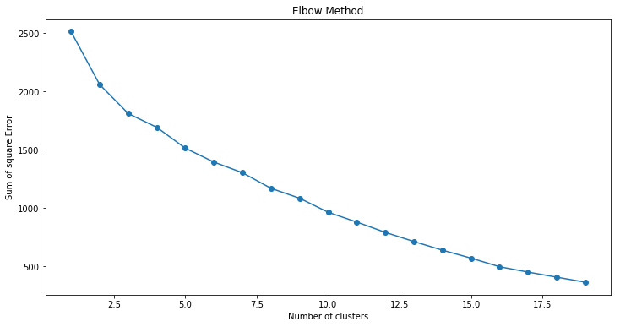
Clustering
Considered 10 number of clusters

Slide 12
Evaluation
Randomly pick one user and get recommendations and compare these recommendation with position of interest and has around 35% accuracy.
Eliminate user applied jobs while recommending and while evaluating compare it with user applied jobs.
Predicting the ratings a user would give to job
Compare the query with recommendations in content, the accuracy was nearly 75%.

Slide 13
Hybrid Recommendation
Combining the recommendation made by all three algorithms.
The issues tried to resolve to an extent are Cold-Start, serendipity and by clustering data the new job ids can be recommended.
Improvements
Clustering can be done on job data and recommended jobs that are similar to the applied jobs and thus increase the number of recommendations.

Slide 14
Thank You

